Slide 1
Midterm Project
Lydia

Slide 2
Concept / Theme
Portfolio
Lydia’s Creative Journey
Idea: Showcase my artistic growth through a timeline, from childhood to the present, focusing on a different art form at each stage of the process.

Slide 3
Inspiration
website：
https://www.cotta-studio.com/

Slide 4
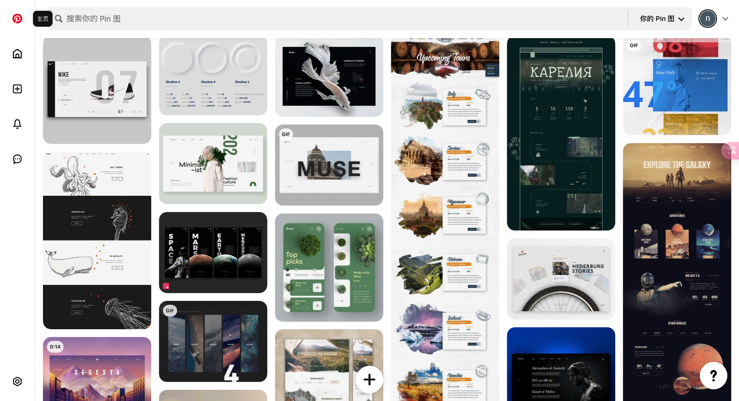
Inspiration
Pinterest collection

Slide 5
Concept / Skills
We have leaned：
Basic Structure(<!DOCTYPE html>, <head>, <body>, <title>)
Text Elements (<h1> - <h6>, <p>, <span>)
Lists and forms(<ul>, <ol>，(<input>, <textarea>， <button>)
Images & Links (<img>, <a>)
Typography、Layout（Flexbox，Grid，Positioning）、Background & Colors
Animations（transition，transform: scale/rotate/skew，Click / hover animation）
Navigation Bar（Using flexbox for layout）
Responsive Design
I need to learn：
Scroll-triggered animations
Advanced CSS Grid（Making the artwork showcase more flexible using grid-template-columns）
More advanced Flexbox techniques
Better UI styling
CSS Variables
Full-Screen Image on Click

Slide 6
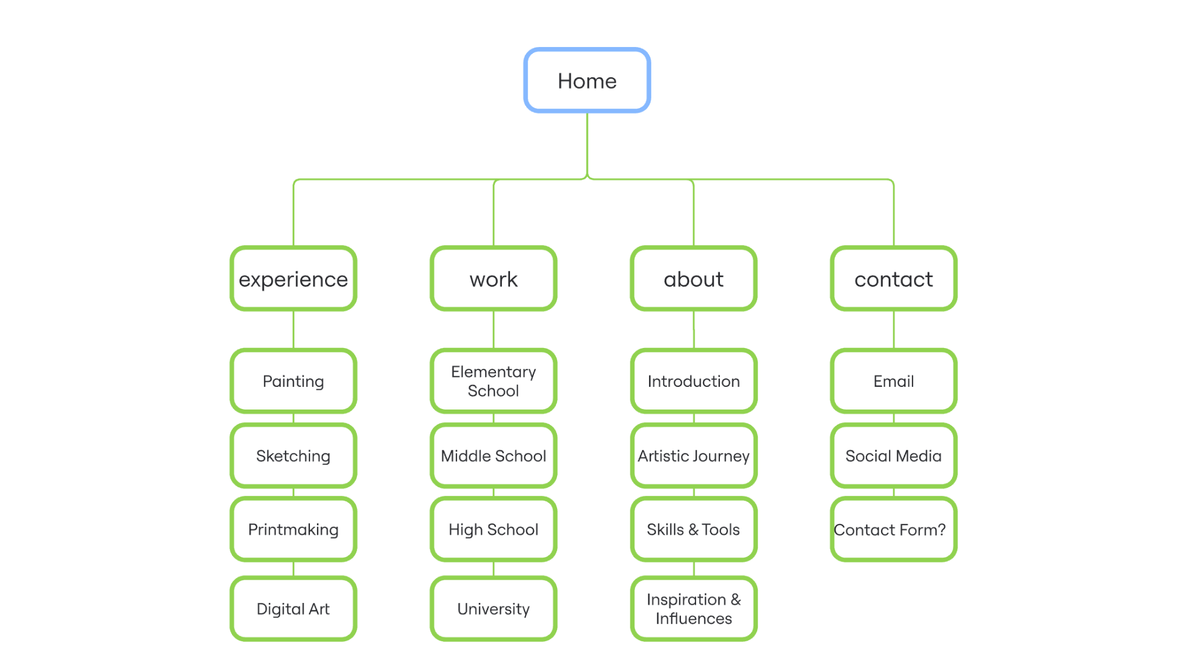
Sitemap

Slide 7
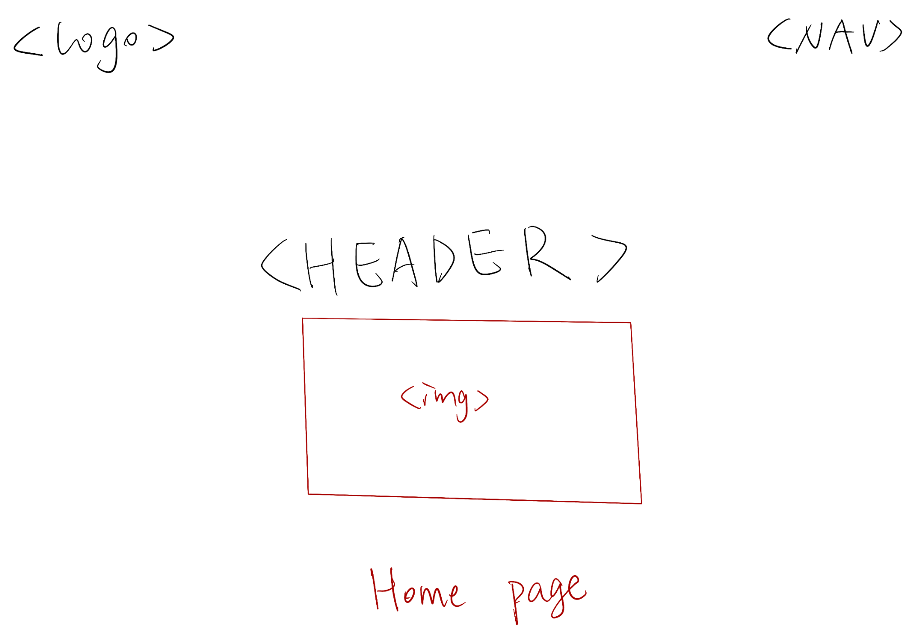
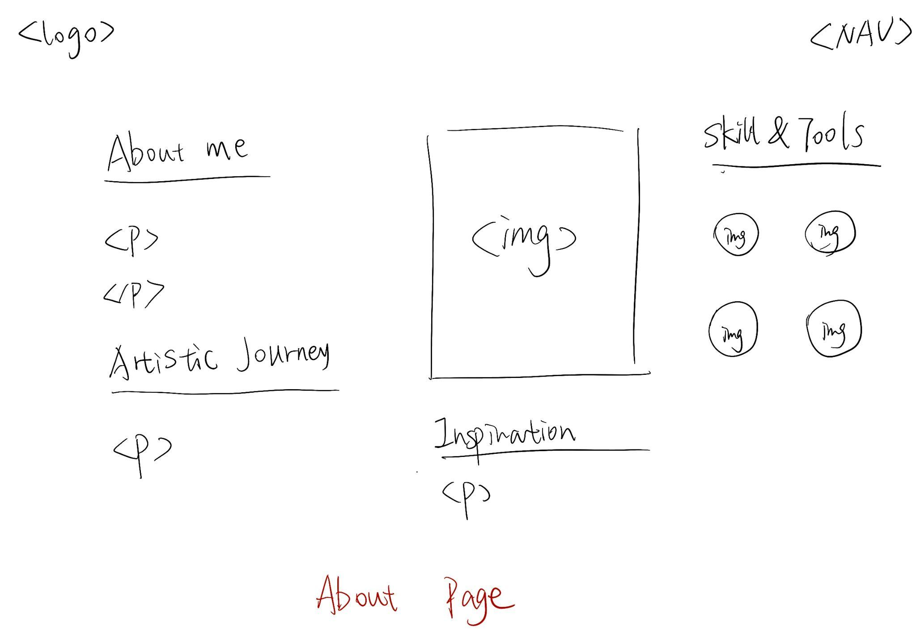
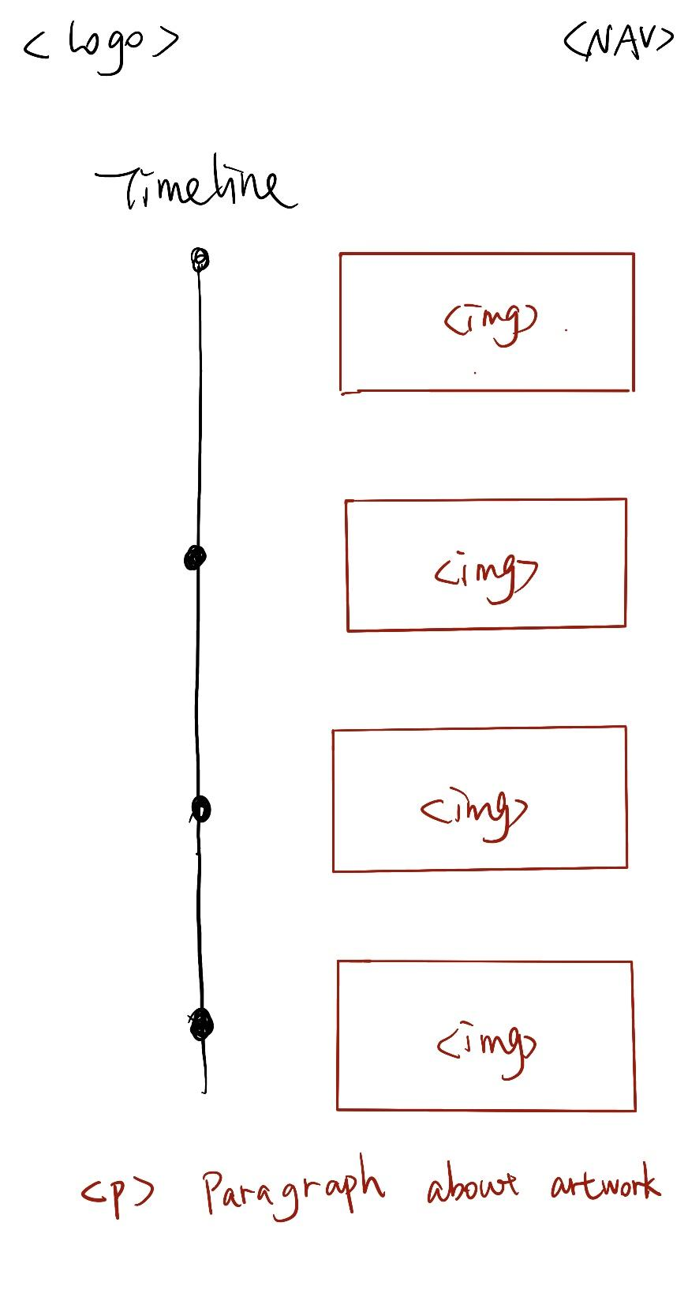
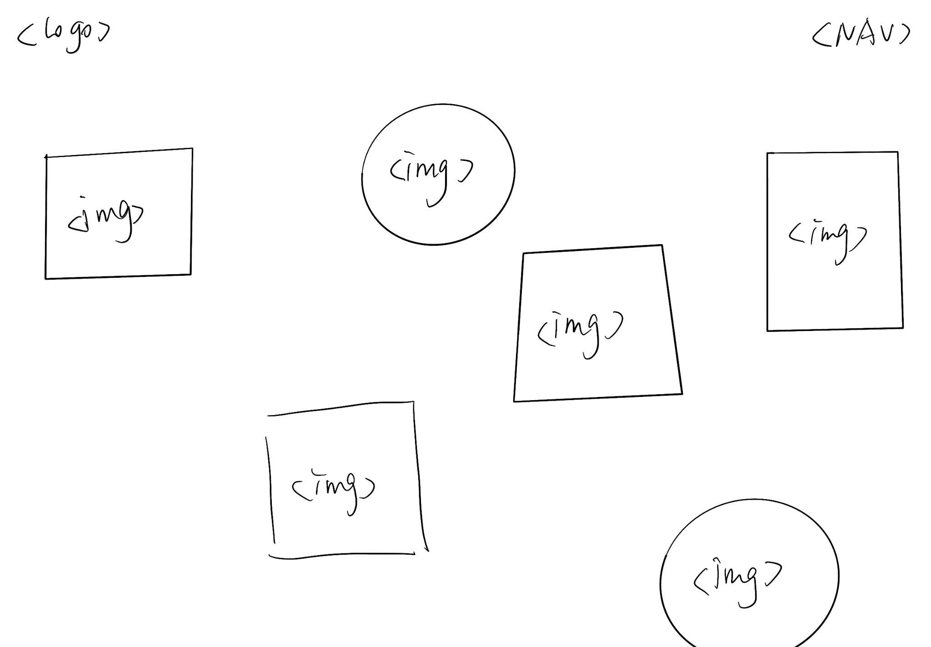
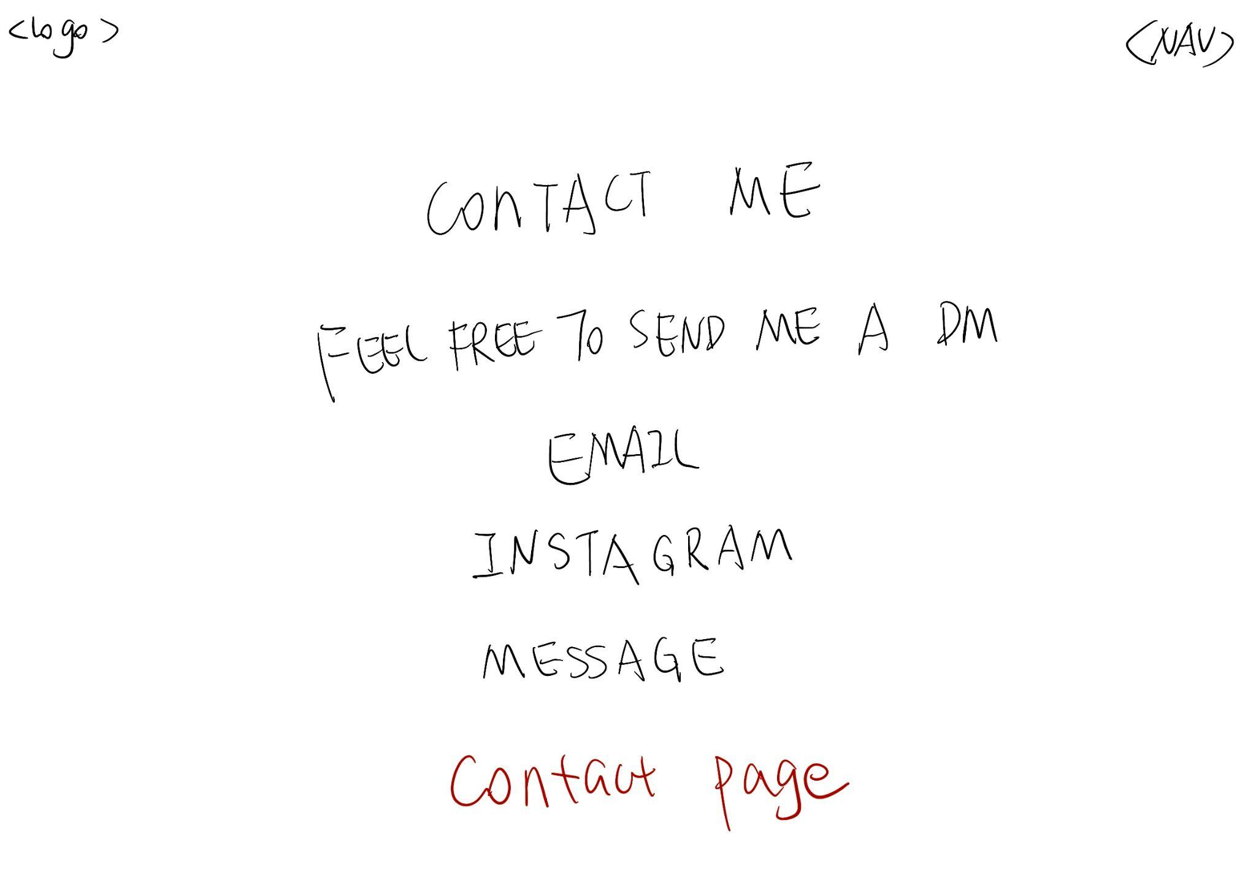
Wireframe

